Slide 1
Exploring the impact of cultural differences in sleep patterns on mental health
By
Musa Muhammad Jibril
FE/23/54228505

Slide 2
INTRODUCTION
Sleep is a fundamental aspect of human biology, essential for maintaining physical health, cognitive function, and emotional well-being. Yet, the ways in which individuals experience and prioritize sleep are profoundly influenced by cultural factors embedded within their societies. Cultural norms, values, traditions, and beliefs shape not only when and how people sleep but also their perceptions of sleep quality and its relationship to mental health.
Understanding the interplay between cultural differences in sleep patterns and mental health is crucial for addressing disparities in well-being across diverse populations. This intersectionality underscores the need to move beyond a one-size-fits-all approach to sleep health promotion and intervention, recognizing and respecting the unique cultural contexts in which individuals live and sleep.

Slide 3
AIM AND OBJECTIVES
AIM
To investigate the impact of cultural differences in sleep patterns on mental health outcomes and identify strategies for promoting culturally sensitive approaches to sleep health promotion and intervention.
OBJECTIVES
Identify and characterize cultural differences in sleep behaviors, including bedtime routines, sleep duration, sleep-wake schedules, and attitudes toward sleep hygiene practices.
Explore how cultural norms, values, traditions, and socio-economic factors influence individuals' sleep patterns within diverse cultural contexts.
Identify and characterize cultural differences in sleep behaviors, including bedtime routines, sleep duration, sleep-wake schedules, and attitudes toward sleep hygiene practices.
Explore how cultural norms, values, traditions, and socio-economic factors influence individuals' sleep patterns within diverse cultural contexts.

Slide 4
PROBLEMS STATEMENTS
Cultural variations in sleep patterns may contribute to disparities in mental health outcomes among diverse populations, yet the mechanisms underlying these relationships remain poorly understood, hindering the development of effective interventions to address mental health disparities.

Slide 5
METHODOLOGY
1. Study Design:
Justify the chosen approach in relation to the research aims and objectives.
2. Participants:
Specify the characteristics of the study population, including age, gender, cultural background, and any inclusion/exclusion criteria.
3. Data Collection:
Outline the instruments and measures used to assess cultural differences in sleep patterns and mental health outcomes, such as standardized questionnaires, interviews, or observational assessments.
4. Cultural Assessment:
Explain how cultural factors are assessed and operationalized within the study, including cultural norms, beliefs, values, and practices related to sleep.
5. Sleep Assessment:
Detail the methods used to assess sleep patterns and behaviors, including sleep duration, quality, efficiency, latency, and disturbances.
6. Mental Health Assessment:
Describe the measures and instruments used to assess mental health outcomes, including depression, anxiety, stress, and overall psychological well-being.
7. Data Analysis:
Outline the statistical or qualitative methods used to analyze the collected data, considering the research questions and objectives.
8. Ethical Considerations:
Address ethical considerations related to participant recruitment, informed consent, confidentiality, and data protections.
9. Limitations:
Acknowledge potential limitations of the study, such as sampling biases, cultural measurement issues, and generalizability constraints.

Slide 6
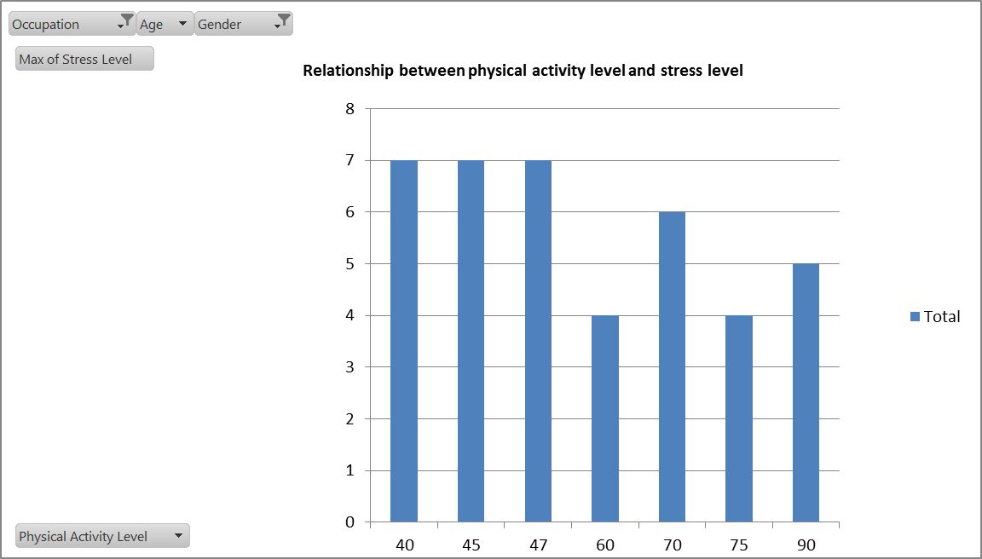
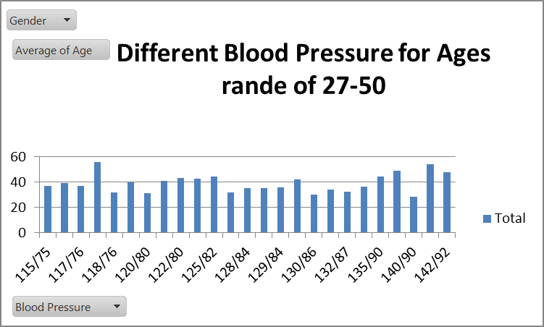
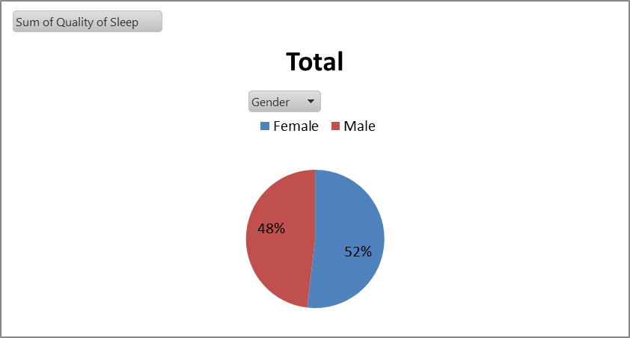
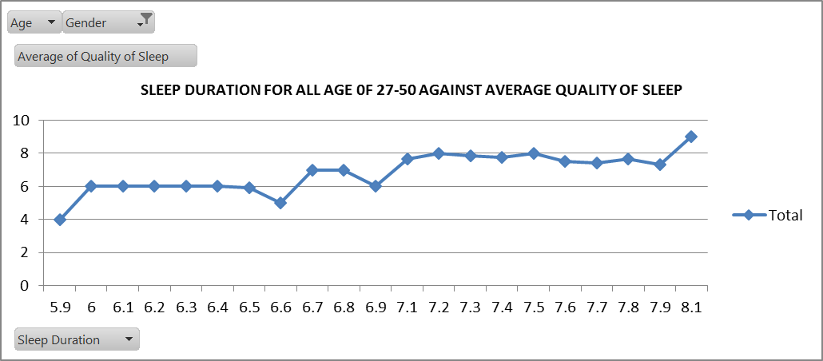
RESULTS AND DISCUSSION

Slide 7
DISCUSSION
Despite the growing recognition of cultural diversity in sleep patterns, research examining its implications for mental health remains relatively limited. By investigating how cultural factors influence sleep behaviors and subsequent mental health outcomes, we can gain valuable insights into the complex interplay between culture, sleep, and psychological well-being. Such knowledge is essential for developing culturally sensitive interventions to promote healthy sleep habits and mitigate mental health disparities among diverse populations.

Slide 8
RECOMMENDATION
Develop and implement sleep education programs that are culturally sensitive and adapted to the specific beliefs, practices, and traditions of different cultural groups.
Collaborate with community leaders, cultural organizations, and healthcare providers to ensure the effectiveness and accessibility of these programs within diverse communities.
Enhance access to mental health services that are culturally competent and inclusive of diverse cultural backgrounds.
Train mental health professionals in culturally sensitive approaches to assessment, diagnosis, and treatment, considering the influence of cultural factors on sleep patterns and mental health outcomes.
Foster collaboration between researchers, healthcare providers, policymakers, and community stakeholders to develop evidence-based interventions and initiatives that address the complex interplay between culture, sleep, and mental health

Slide 9
CONCLUSION
Identify culturally sensitive strategies and tailored interventions for promoting healthy sleep habits, addressing sleep-related disparities, and enhancing mental health resilience across different cultural groups.

Slide 10
THANKS FOR TIME AND LISTENING

